Slide 1




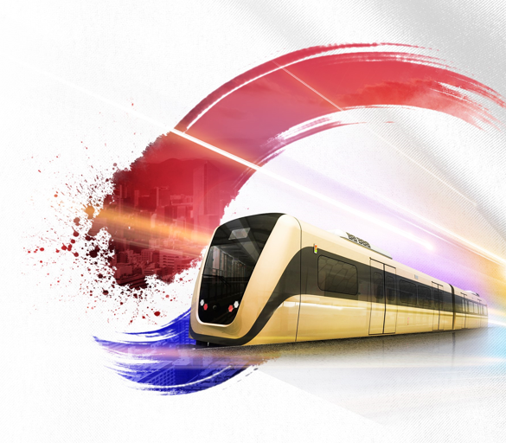
RAILWAY CONFERENCE
Intergration, Development and Quality of Life
October 26, 2021
From 14:00 To 17:00
Paseo Galeria Event Center
Asunción, Paraguay

